Slide 1

VIRTUAL SHOPPING SYSTEM
Devloped by S.K.S.H.
“Just Click and Shop”
Submitted to
Dr. Humera Tariq

Slide 2

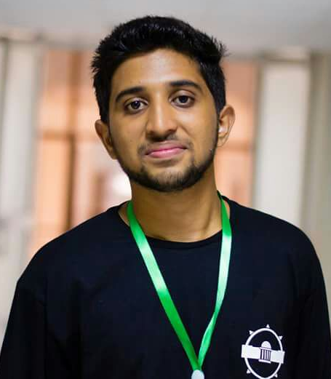
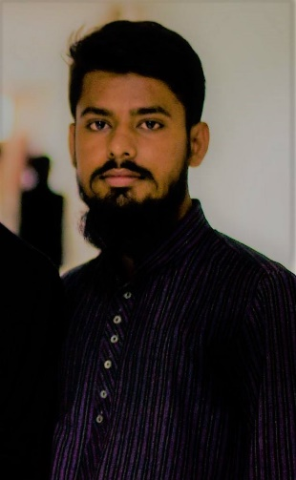

Muhammad Salman Khan B15158053
DEVELOPERS
Kashan Zahoor Siddiqui
B15158029
Shehrooz Saleem
Khan
B15158068
Hasan Abdul Rasheed
B15158020
Submitted to Dr Humera Tariq

Slide 3

Introduction
This software virtual shopping system is a concept of online shopping in which you can easily shop just by click.

Slide 4
Objective
Virtual Shopping System is developed to make the shopping experience easy and convenient for the customers.

Slide 5

Importance
The Customers do not need to find the specific item at a specific place. They can select and buy them all at a single screen and easy to use interfaces

Slide 6
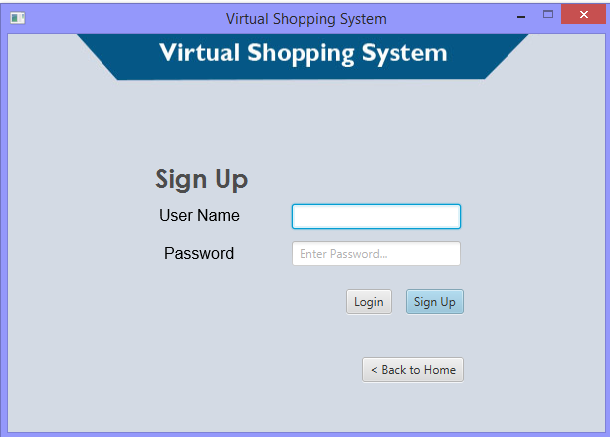
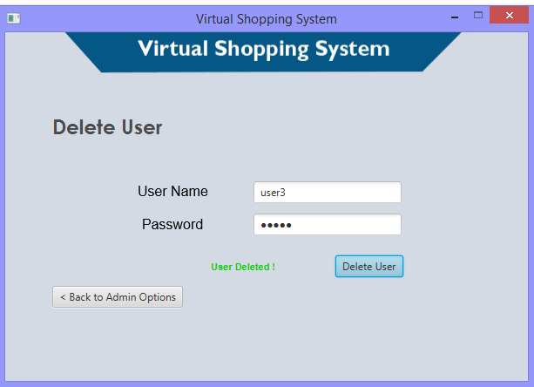
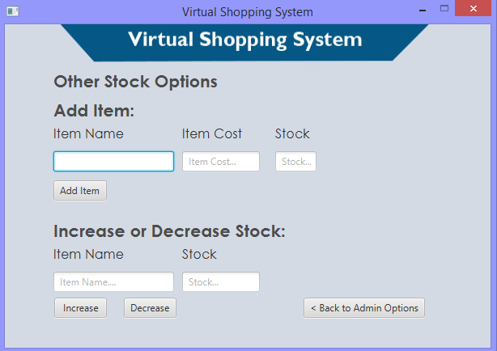
Sample Input

Slide 7
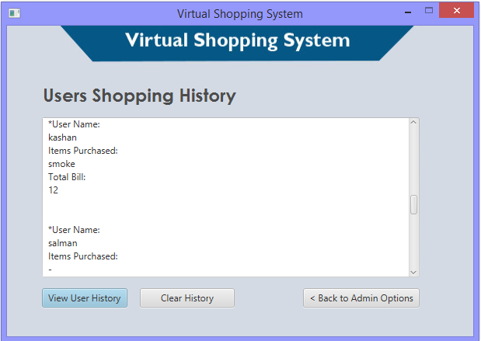
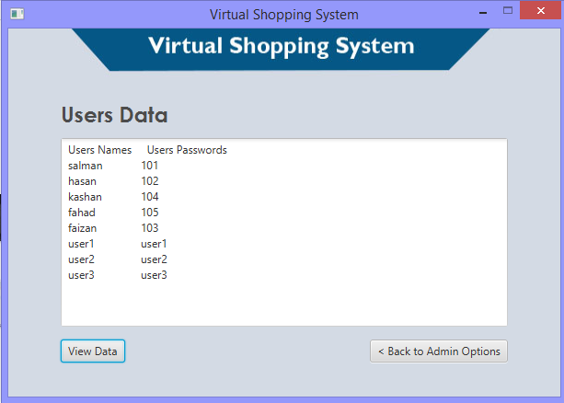
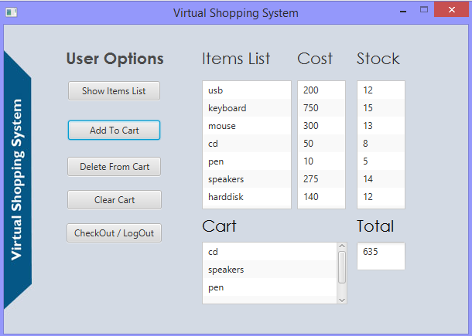
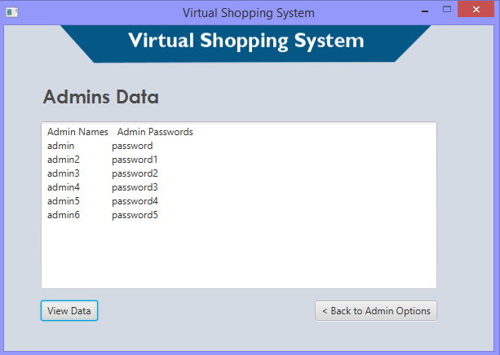
Sample Output

Slide 8
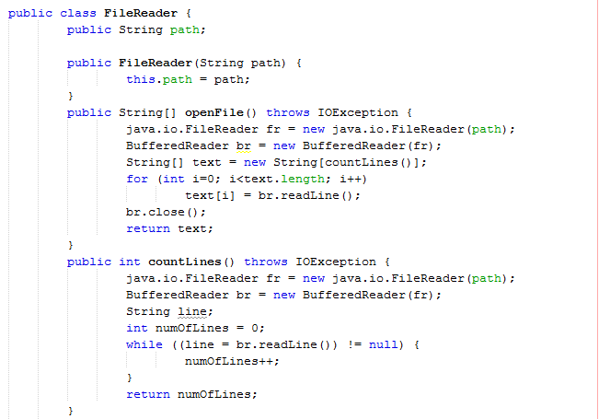
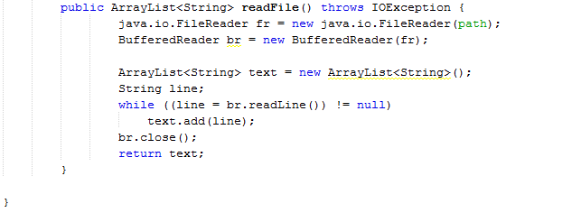
File Reader

Slide 9
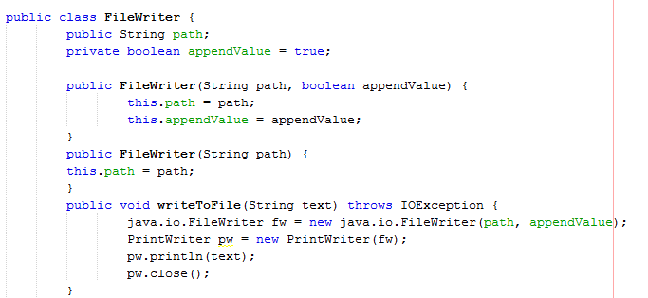
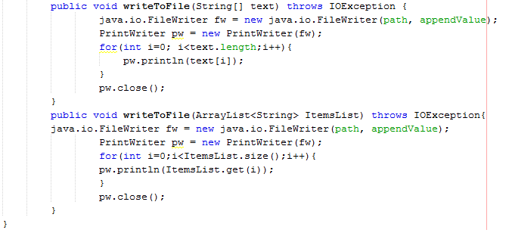
File Writer

Slide 10
Text Files
These are the text files we have used in our project
Admins Names
Admins Password
User Names
User Passwords
Items Name
Stock
Item Cost
Client Login History

Slide 11



Attributes Handling
Default
String User Name;
User Name
String Password;
Boolean j=false;
We use the boolean for a while loop
Int w = 0;

Slide 12
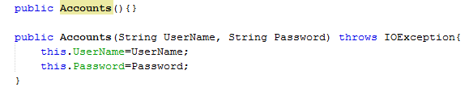
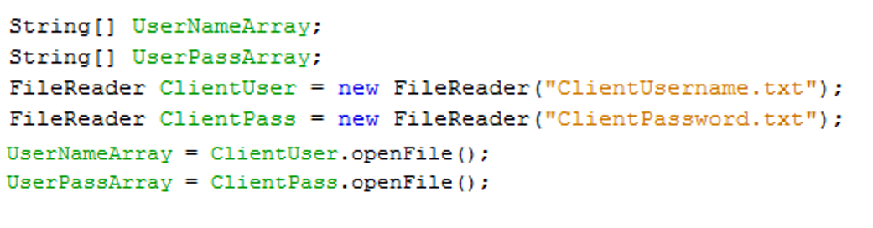
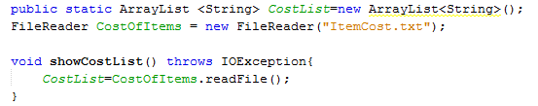

Constructor Calling
Here are the few Examples of constructor calling from our code

Slide 13
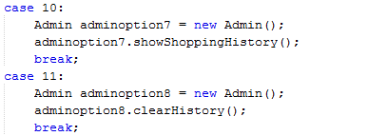
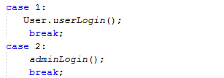
Method Calling
Here we call the method by creating the object of type Admin with no arguments
Here we directly call the method from the another class by using the dot operator
Here we call the method by creating the object of type Admin with arguments name and pass

Slide 14
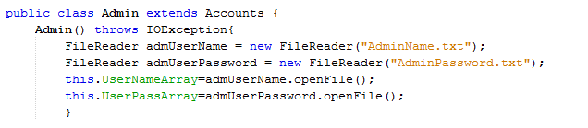
Inheritance
We inherit the Admin class from Account class through inheritance now Admin class had the direct access of the attributes and method of class Accounts.

Slide 15
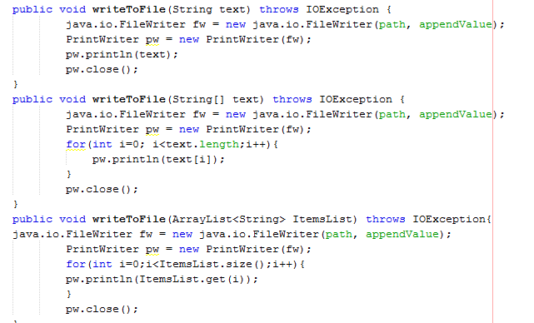
Polymorphism
Overloading

Slide 16
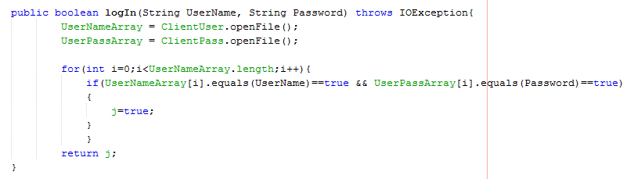
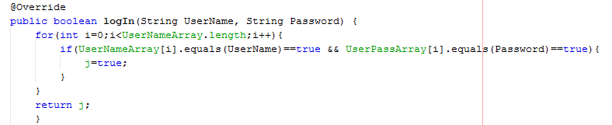
Overriding
This Login method was first used in the Accounts Class (Parent Class)
Then we used in the Admin Class which is the child class or sub class or Account Class which over rides it

Slide 17

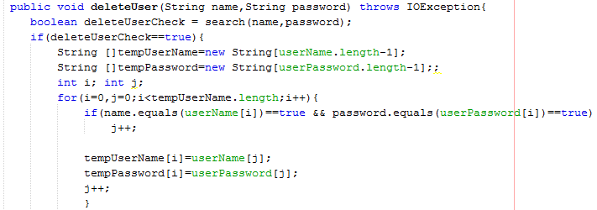
Things used in Project
Parsing
Deep copy
Shallow coy

Slide 18
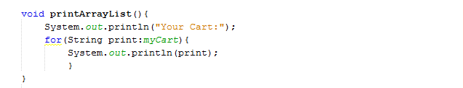
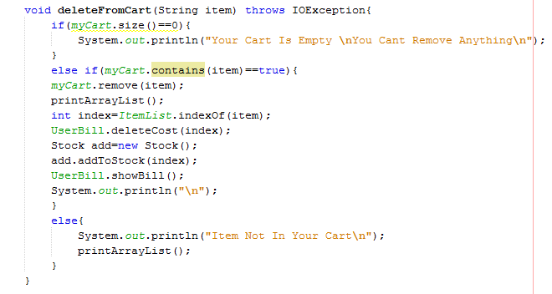
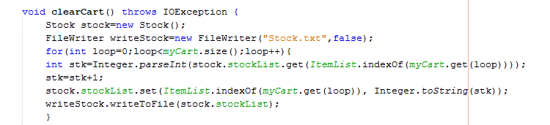
ArrayList and Array

Slide 19
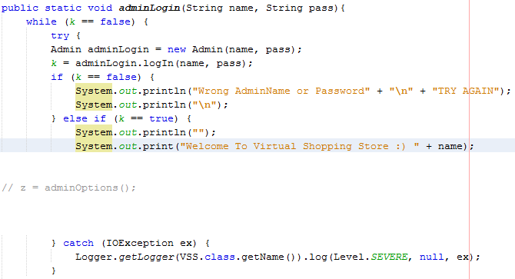
Exception Handling
Here we used try and catch to handle the exception of any kind of Input Error.

Slide 20
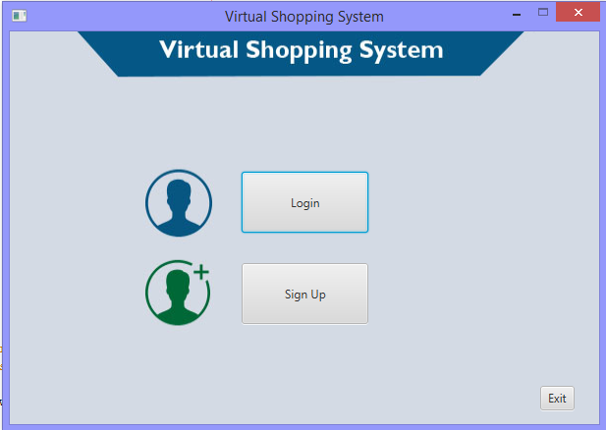
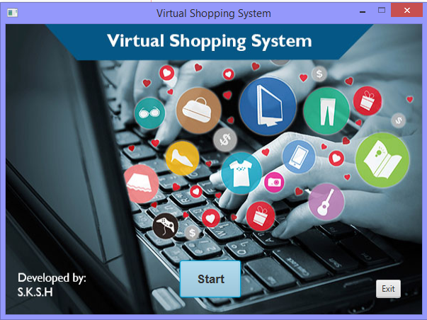
Virtual Shopping System

Slide 21
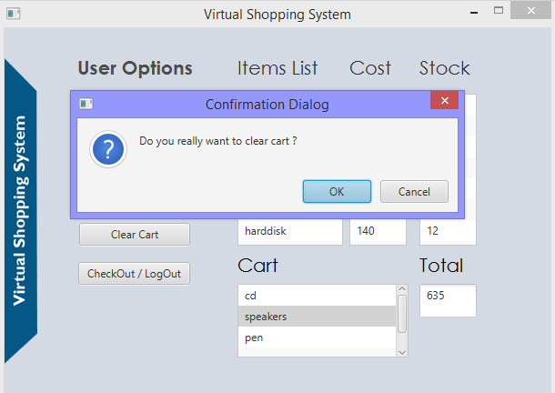
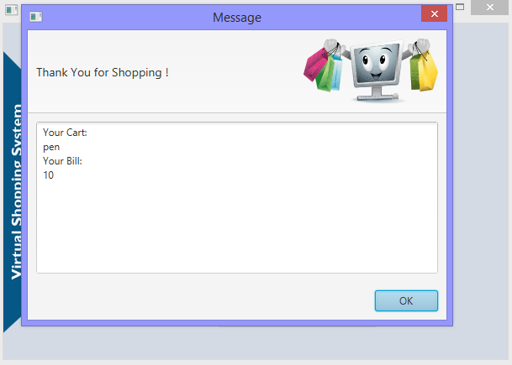
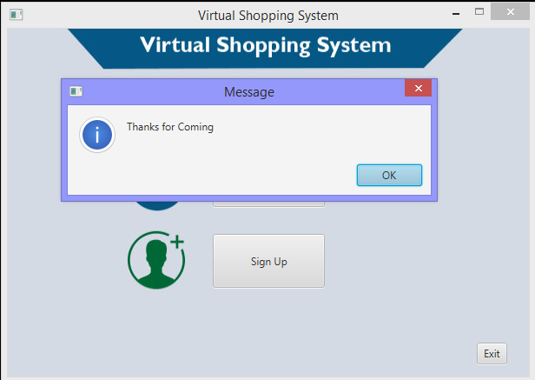
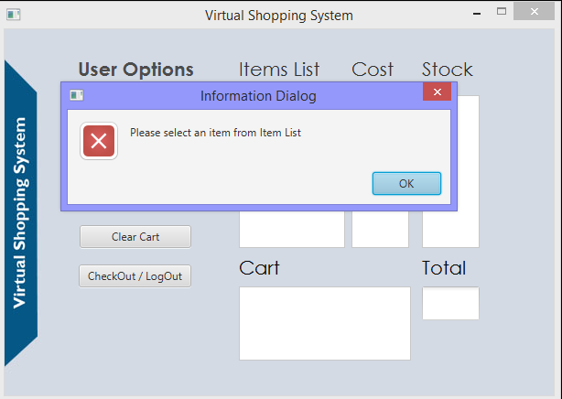
User Options

Slide 22
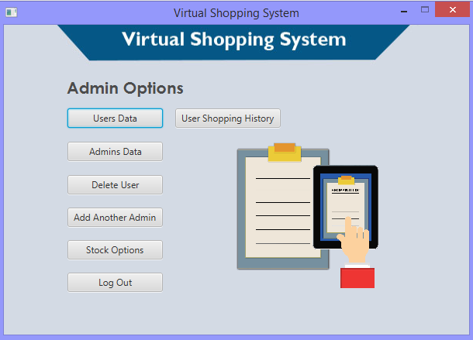
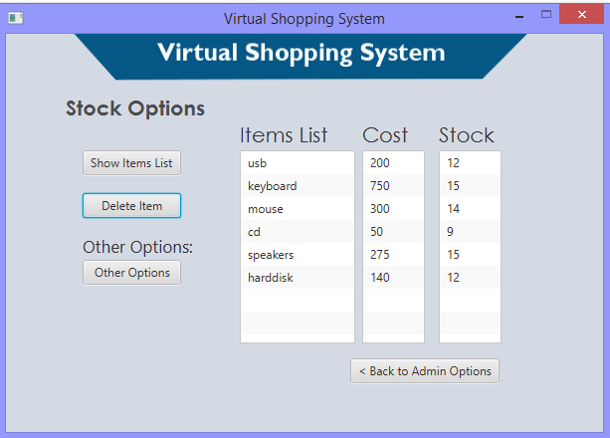
Admin Options

Slide 23
UML

Slide 24
Learning and Achievements
The most important thing we have learnt through this project is how to co-ordinate with the group members which will help us in our future life
We have learnt “Graphical user interface” (Java FX) which was interesting as well as difficult.
It was our first experience in handling such a high level project and was difficult to manage but some how we did it.
In the beginning we bad no idea how the project will be build. But with our untiring efforts and self confidence we successfully completed it.

Slide 25
Improvements and Future Work
The improvement need in this project is that this is by using networking we can easily use this software from anywhere.
And instead of filing we have to use database which is more convenient and easy to handle.

Slide 26
THANKYOU! Your Questions Are Important…

